Slide 1
College Scorecard Analysis
Vik, Joey, Wei, Nein
4/26/23

Slide 2
Agenda
Dataset Description
Data Processing and Cleaning
Exploratory Analysis
Regression and Predictive Model
Key Findings & Summary

Slide 3
Dataset Description

Slide 4
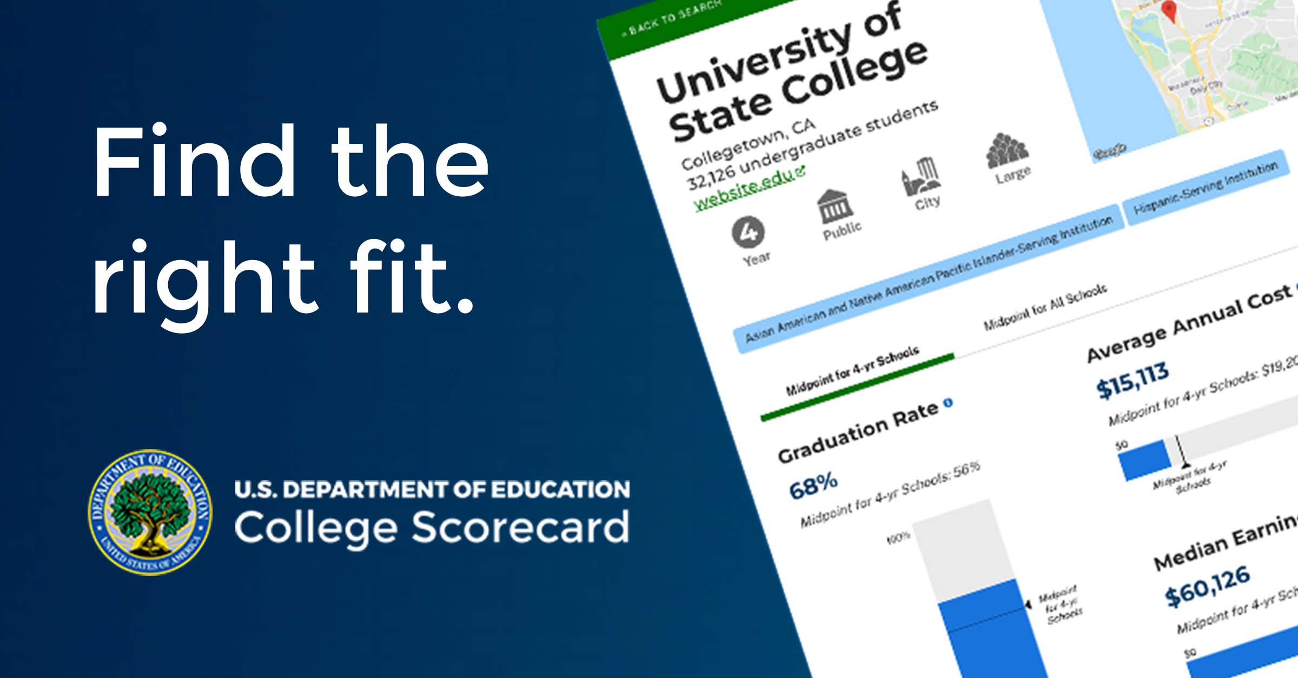
College Scorecard
A US Department of Education dataset on colleges and universities
Includes data on student completion rates, earnings, and more
Used for research and analysis in higher education policy and beyond.

Slide 5
Attributes and Size
1. The College Scorecard dataset includes data on over 7,000 colleges and universities in the United States. The dataset is quite large and contains over 2,000 variables for each institution.
2. We limited the scope of our research to four aspects: gender, faculty, education cost, and regional factors, and we explored the metrics and their relationships with students’ performances after graduation.
3. We selected 40 columns that are within our scope, with 6451 entries.

Slide 6
Data Processing and Cleaning
1. Access the API
2. Identify the columns needed
3. Rename columns
4. Created New Variables

Slide 7

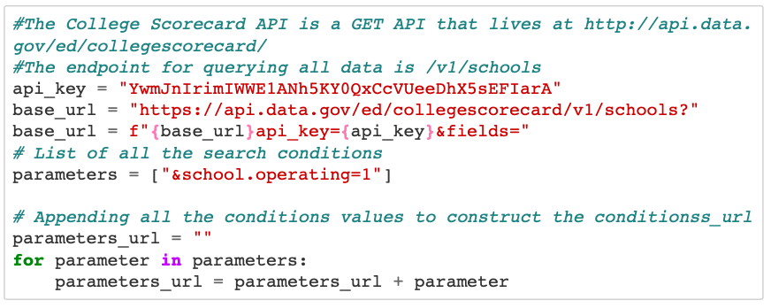
1. Access the API
Access the API from US department of Education
We have to create account to access the key
The parameters only observe the school still operating

Slide 8
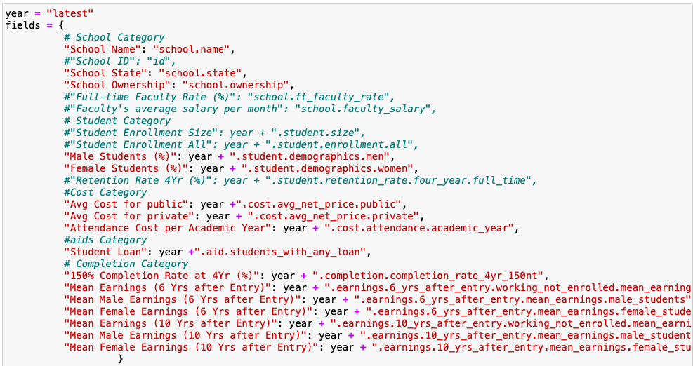
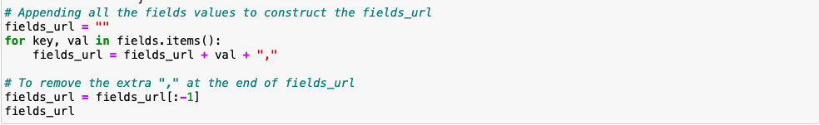
2. Identify the columns needed
Get the necessary 40 columns from the API
Rename the variables
Pulled the data using requests

Slide 9
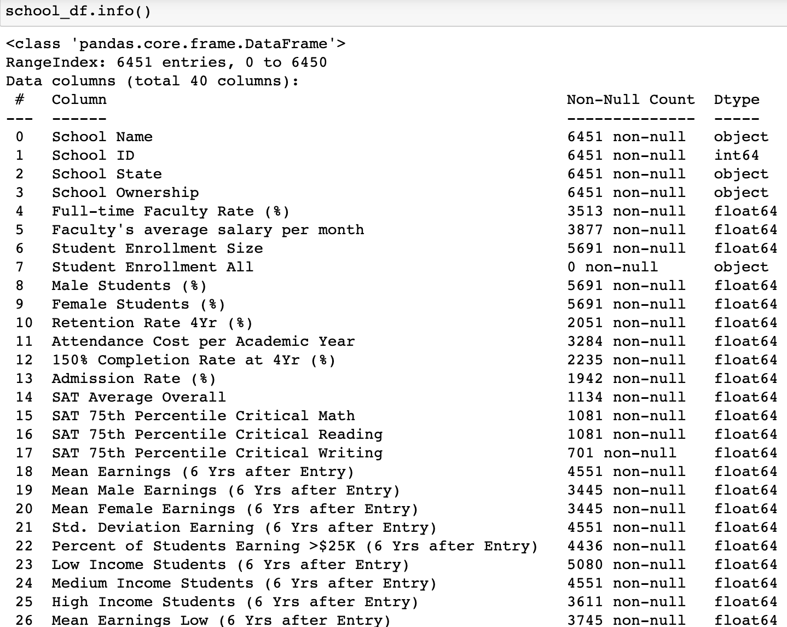
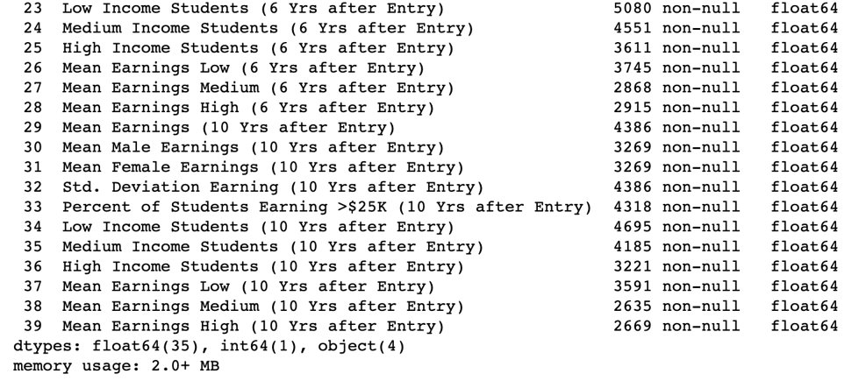
3. The Data Frame
40 columns
6451 entries (date: 2023.4.19)

Slide 10
4. Feature Engineering
We performed necessary feature engineering by changing numbers in “School Ownership” from 1 to ”public” and combining 2 and 3 into “private”.

Slide 11
Exploratory Analysis
Gender Differences vs Earnings
Education Cost vs Earnings
Faculty Salary vs Retention/Earnings
State Wise Differences vs Earnings

Slide 12
Research Question 1: Gender and Student Earnings
How much are gender mean earnings affected by the University they attend?
What is the baseline for mean earnings ten years after a student attends a University? Does it differ by gender?
What aspect of a University most leads to students earning more money ten years after they attend?

Slide 13
Gender Differences
We looked at the differences in mean earnings, between genders, 10 years after student's began their education at their respective Universities.
The data we analyzed was for both public and private Universities, as we wanted our findings to be gender specific.

Slide 14
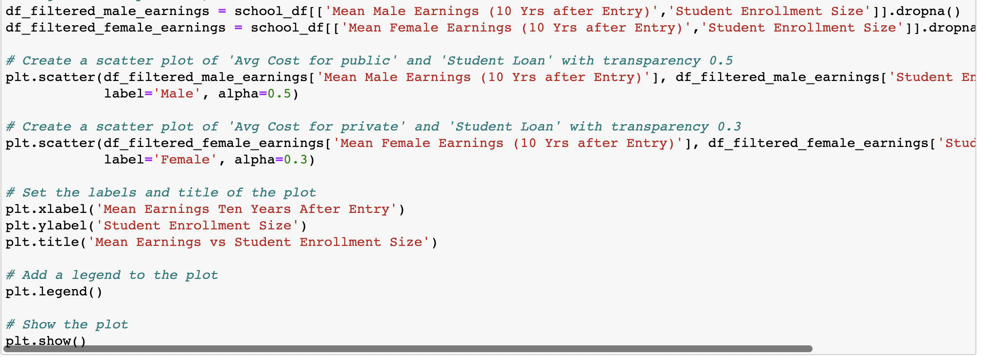
Code To Create Plot

Slide 15
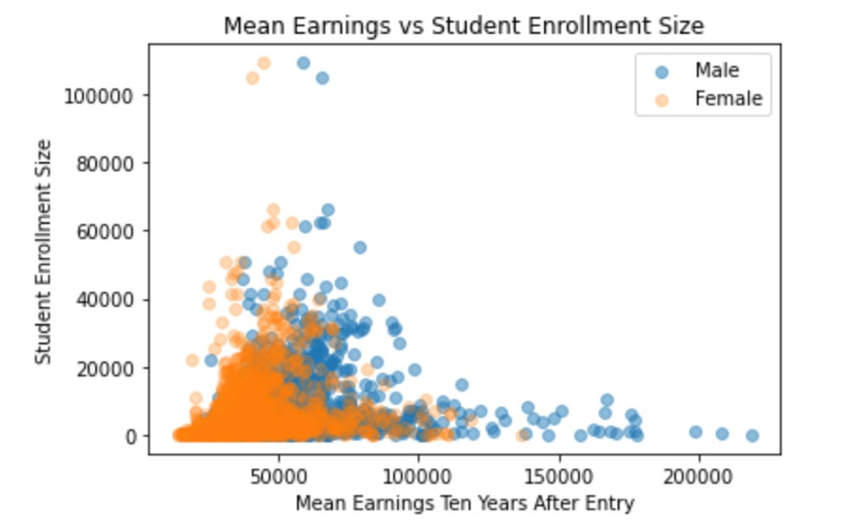
Gender Mean Earnings vs. University Enrollment Size
Students who earn the most attended smaller schools.
Males who attended smaller schools earned up to $225,000, while females who attended smaller schools only earned up to $145,000.

Slide 16
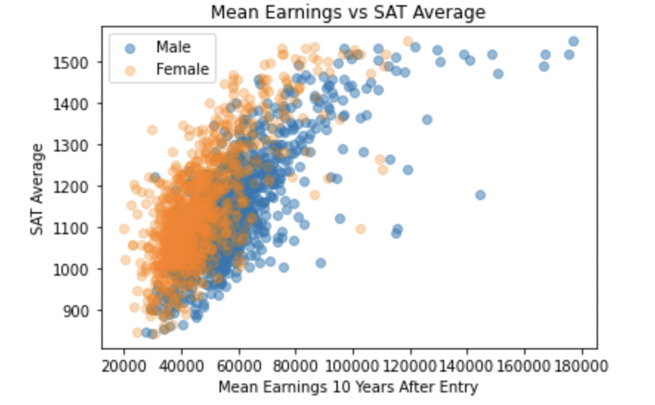
Data Cleaning
Gender Mean Earnings vs. University Average SAT Score
Schools with a higher average SAT score had some students who ended up earning good pay, but it didn’t seem to be a heavy influencing factor.
Males who scored high on the SAT (1300+) earn up to $180,000, while females who scored high only earn up to $120,000.

Slide 17
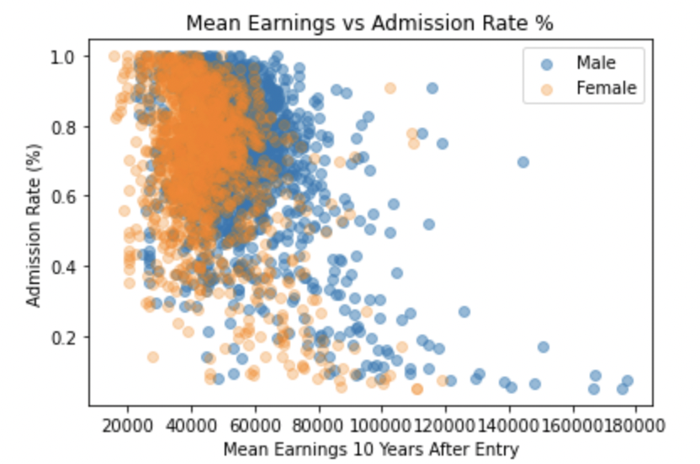
Data Cleaning
Gender Mean Earnings vs. University Admission Rate
Schools with lower admission rates have students who end up earning more money.
Males who attended schools with less than a 20% admission rate earned up to $180,000, while females earned up to $120,000.

Slide 18
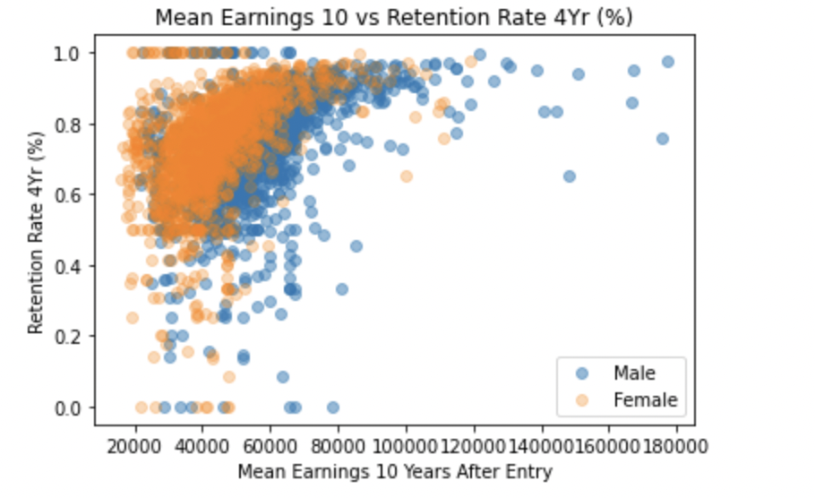
Gender Mean Earnings vs. University Four Year Retention Rate
Schools with lower rates have students who end up not earning good pay – schools a retention rate below 40% seem to have a maximum earning of $80,000 for their students.
Males who attended schools with close to a 100% retention rate earn up to $180,000, while females earn up to $120,000.

Slide 19
Research Question 2: Education Cost and Return
Will a private university student have a better financial status than a public university Student?
Does education cost play a role in students' future earnings?

Slide 20
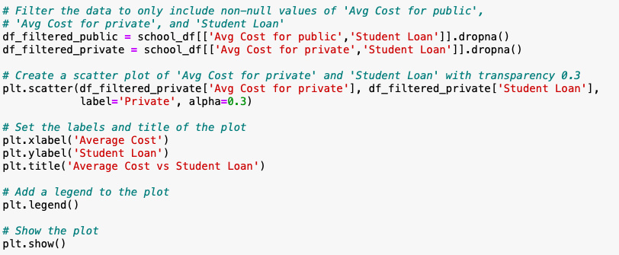
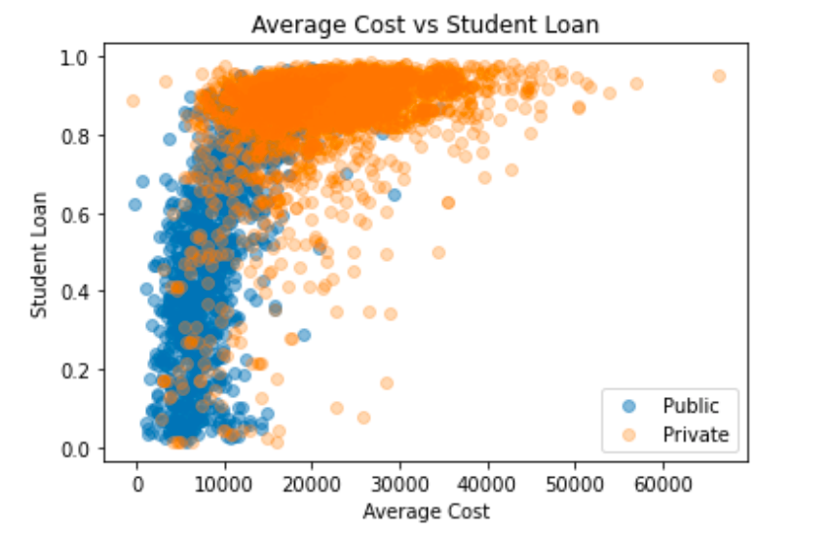
Public and Private University Student’s Financial Status
This plot shows that the Private school students not only pay more than public school students; Most of the private students get student loans to pay for their tuition fees.

Slide 21
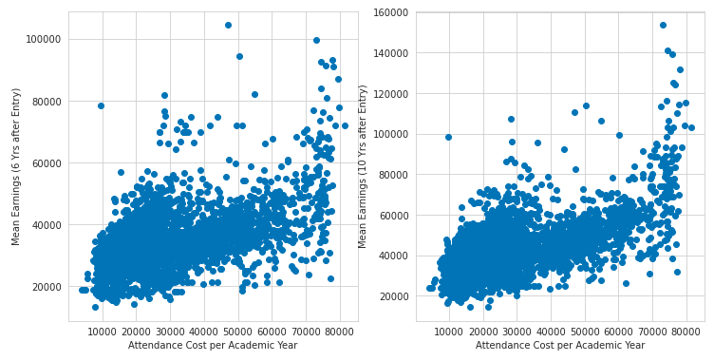
Education Cost vs. Earnings after Graduation
The plot shows the distributions are almost the same between 6 years and 10 years' salary compared to the attendance cost.
So, lets dive deeper to see if the same group of students grow their salary depending on the attendance cost

Slide 22
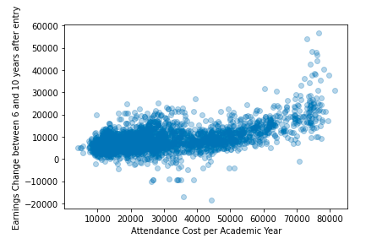
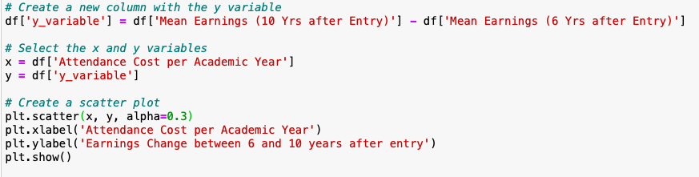
Education Cost vs. Earnings after Graduation
The plot compare the salary change between 6 years and 10 years after graduate (x-variable is 10 y salary – 6 y salary) and the relation with the academic cost.
From the plot we can see that: expect those student pay more than 70,000 per year, no matter how high the attendance cost the student spent in university, the earing change was basically not much different.
The conclusion is: unless you attended the highest cost super college, the expecting salary change in 5 years will almost the same.

Slide 23
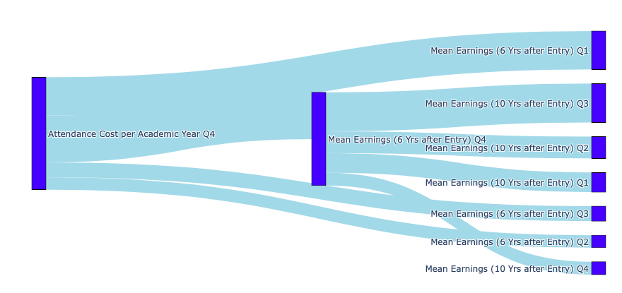
Will those who pay the most (75%) earn most?
The plot compare the salary change between 6 years and 10 years after graduate and the relation with the attendance cost.
Q4 means the 75% of attendance cost

Slide 24
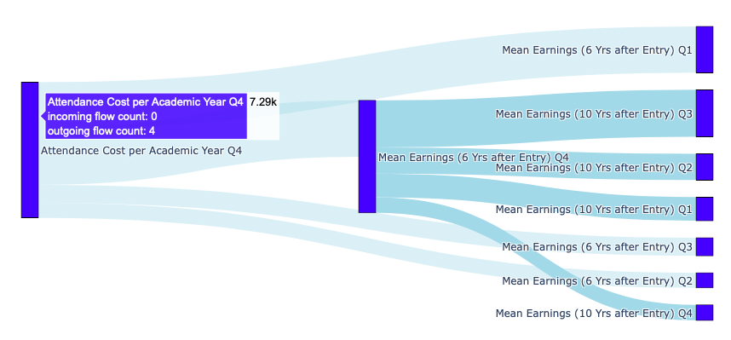
Those who pay the most expensive (Q4)
7.29K remain 50% in the leading place when
6 years after entry

Slide 25
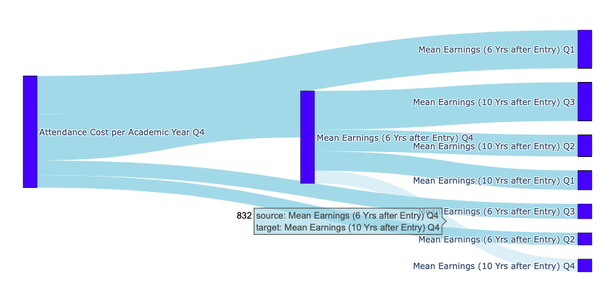
Those who pay the most expensive (Q4)
7.29K remain 11% in the leading place when
10 years after entry

Slide 26
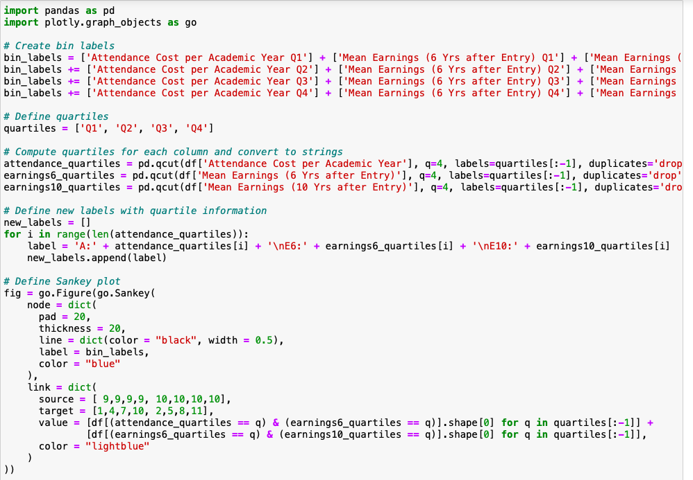
We used the plotly package to plot the interactive fig

Slide 27
Research Question 3: Faculty salary
Does faculty salary have any effect on student completion?
Does faculty salary/tenure have any effect on student earnings in the immediate future?

Slide 28
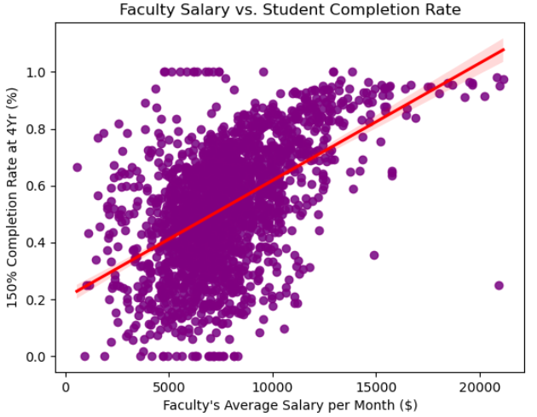
Faculty Salary
Seem to have a direct positive relationship up to a faculty salary of up to $15,000 per month
The 4-year universities with the lowest student completion rates paid their faculty the lowest amount per month
The average salary per month for faculty falls below $10,000

Slide 29
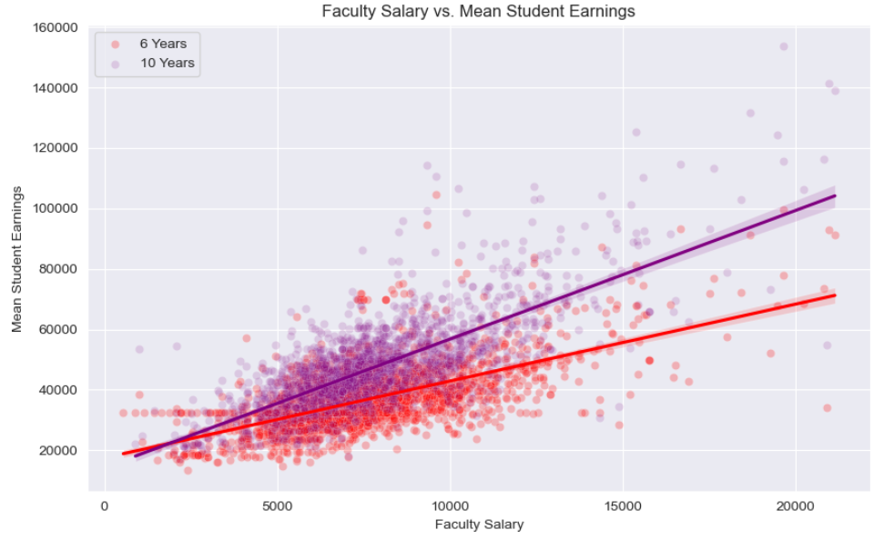
Faculty Salary cont.
Student earnings 6 years after and 10 years after have a direct positive relationship with faculty salary
The highest earning students have gone to universities with faculty that were paid the most across the nation
The salary after 10 years is affected to a greater extent

Slide 30
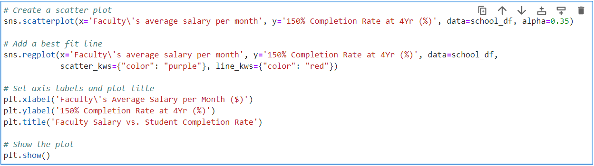
Snippet of Codes

Slide 31
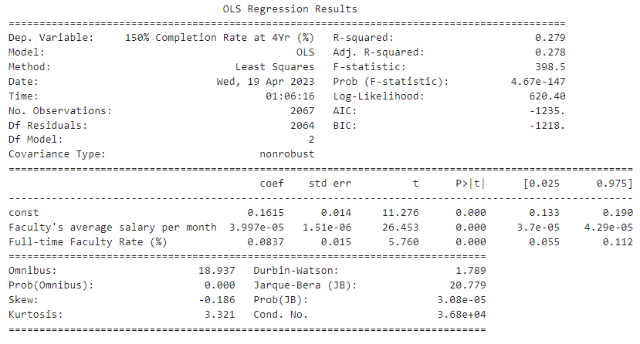
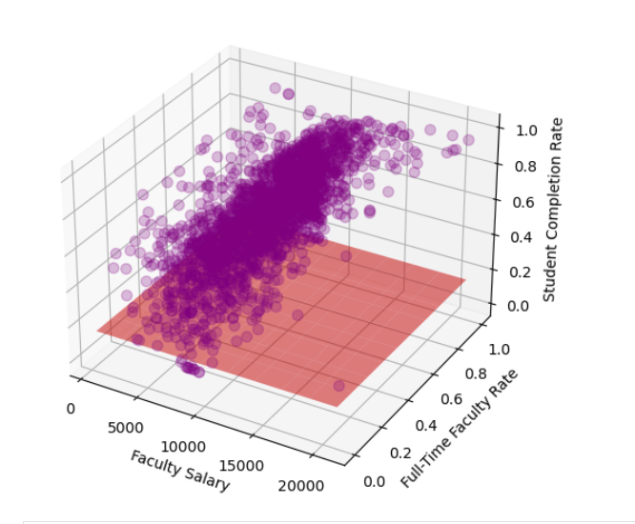
Multivariate Linear Regression
150% Completion Rate at 4Yr ~ Faculty Salary + Full-Time Faculty Rate
Can't establish causal link since R-squared value is 0.279 (<0.7 --> Weak)
However, the p-values are lower than an alpha value of 0.05; the input variables are statistically significant
Needs more input variables to improve the R-squared value and to explain the variability
Notes:
Faculty Tenure and salary needs to be studied further with a deeper analysis to establish a causal link. Our findings do indicate a positive correlation to some extent.
Add slide on student mean earnings
Since this is a social science the R-Squared value won't be too high (anything above 0.3 is considered good)

Slide 32
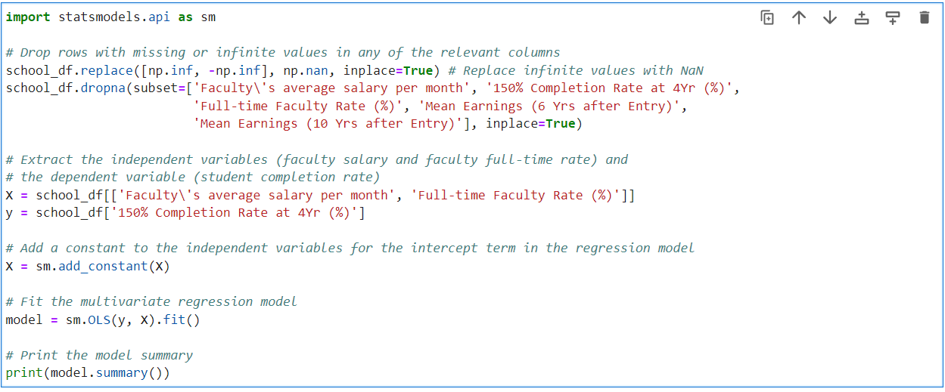
Snippet of Codes

Slide 33
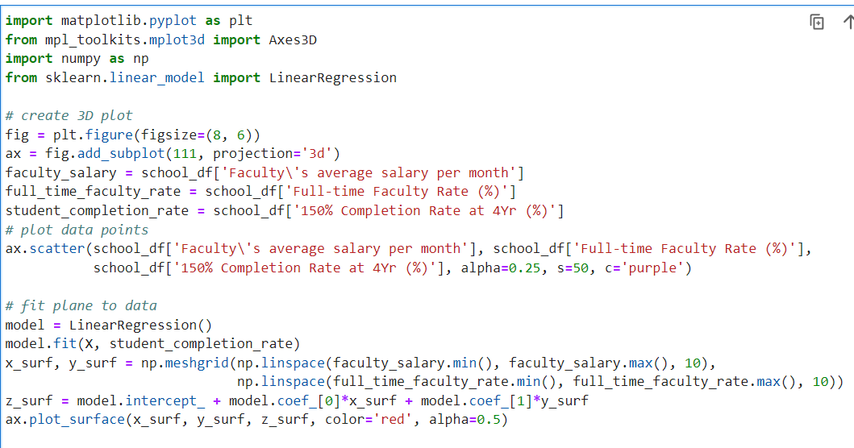
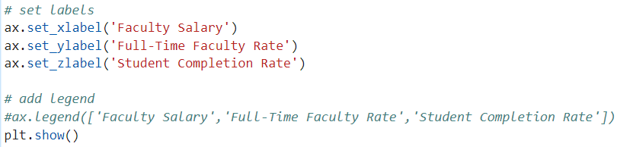

Slide 34
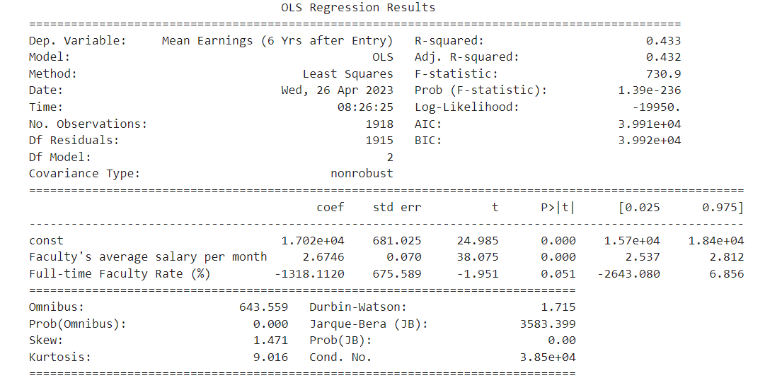
Multivariate Linear Regression cont.
Mean Student Earnings (6 Yrs after Entry) ~ Faculty Salary + Full-Time Faculty Rate
R-Squared value: 0.433
P-value: Full-time Faculty Rate's is 0.051

Slide 35
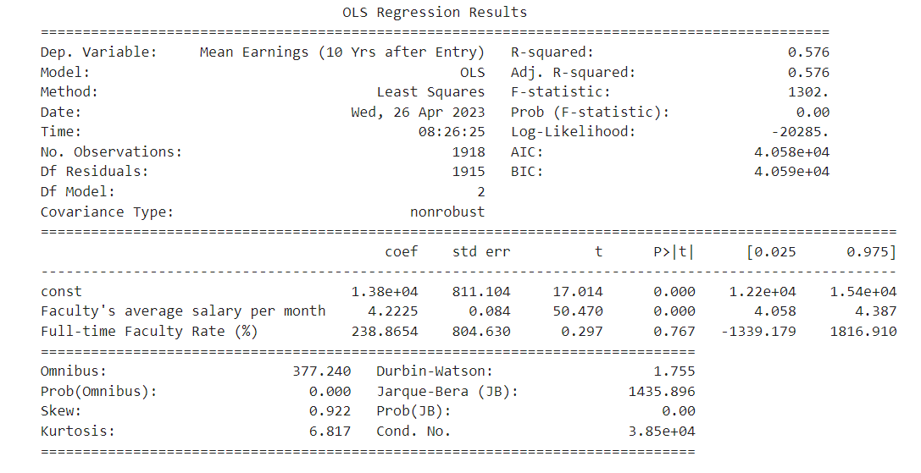
Multivariate Linear Regression cont.
Mean Student Earnings (10 Yrs after Entry) ~ Faculty Salary + Full-Time Faculty Rate
R-Squared value: 0.576
P-value: Full-time Faculty Rate's is 0.767; this variable's effect on Mean Student Earnings after 10 years is insignificant

Slide 36
Research Question 4：Regional differences
Do educational resources differ across the states
Do the performances of students after graduation differ across states?
What are some valid factors for predicting mean earnings after graduation?

Slide 37
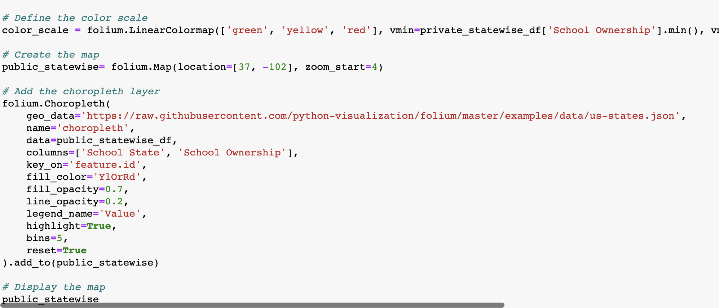
Map Generation Process
Group data by states
2. Used the folium package
3. Define the color scale: setting the min and the max
4. Create the map by defining the location
5. Add the choropleth layer

Slide 38
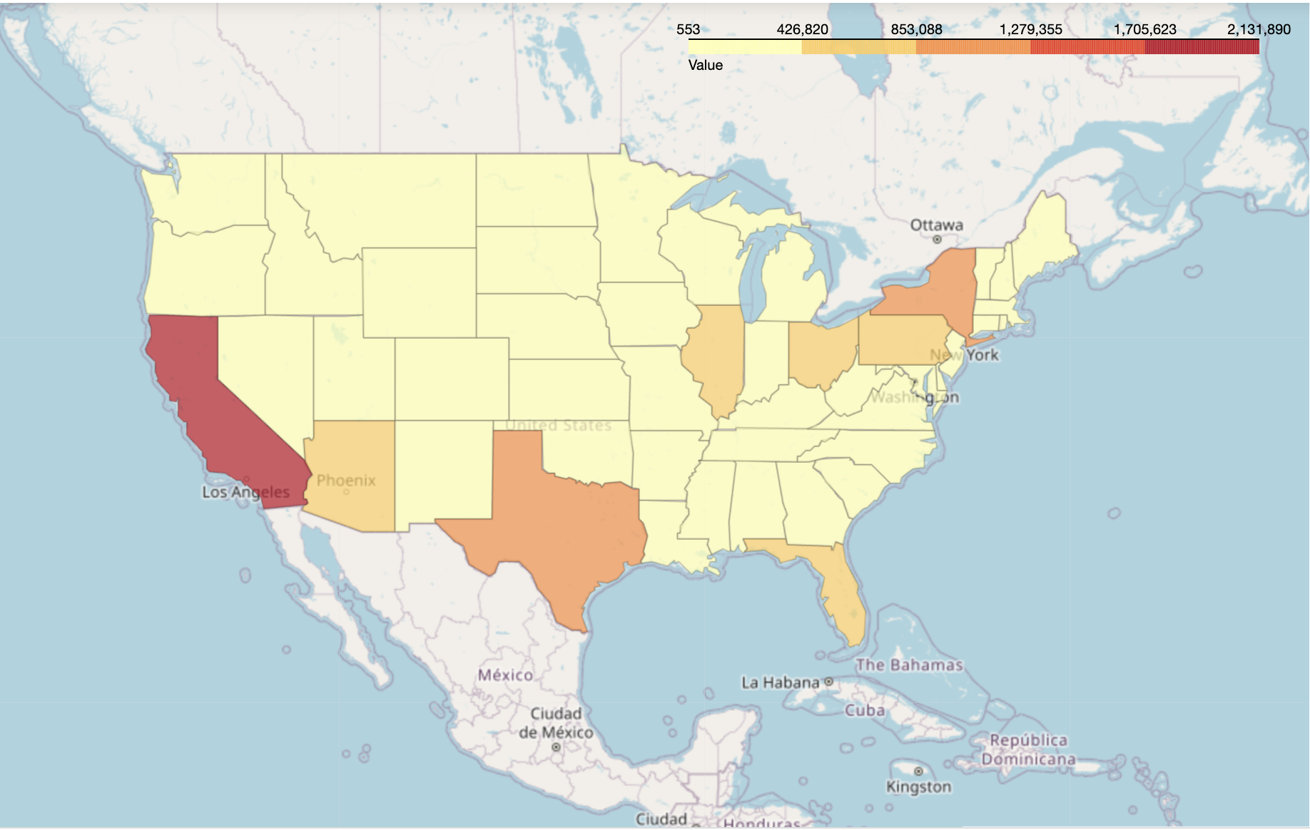
State-wise Data
Enrollment Size State-wise
The top three states with the most enrollment size are California, New York, and Texas.
Inland areas have smaller enrollment sizes compared to the coastal areas.
Reasons: Population Density; Access to Educational Resources; Economics Factor

Slide 39
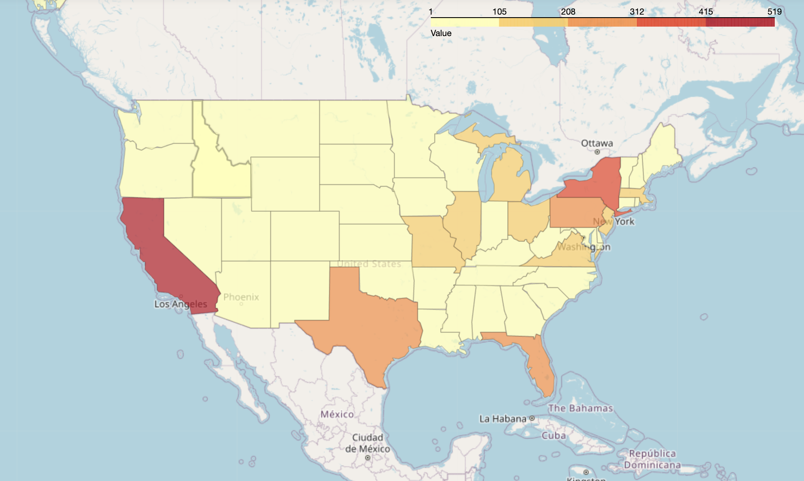
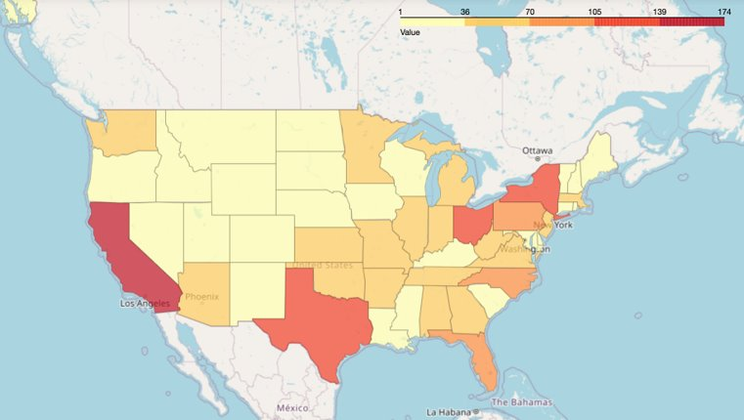
Data Cleaning
Number of Private Schools / Public Schools
1. The states with the highest number of public and private schools are also among the most populous states in the country, so this may reflect a greater need for schools to serve large populations.
2. Some states with high numbers of public schools also have high numbers of private schools: high demand for education in general in these states.
3. There are some regional variations in the number of schools. Costal are generally have more schools.
Private Schools
Public Schools

Slide 40
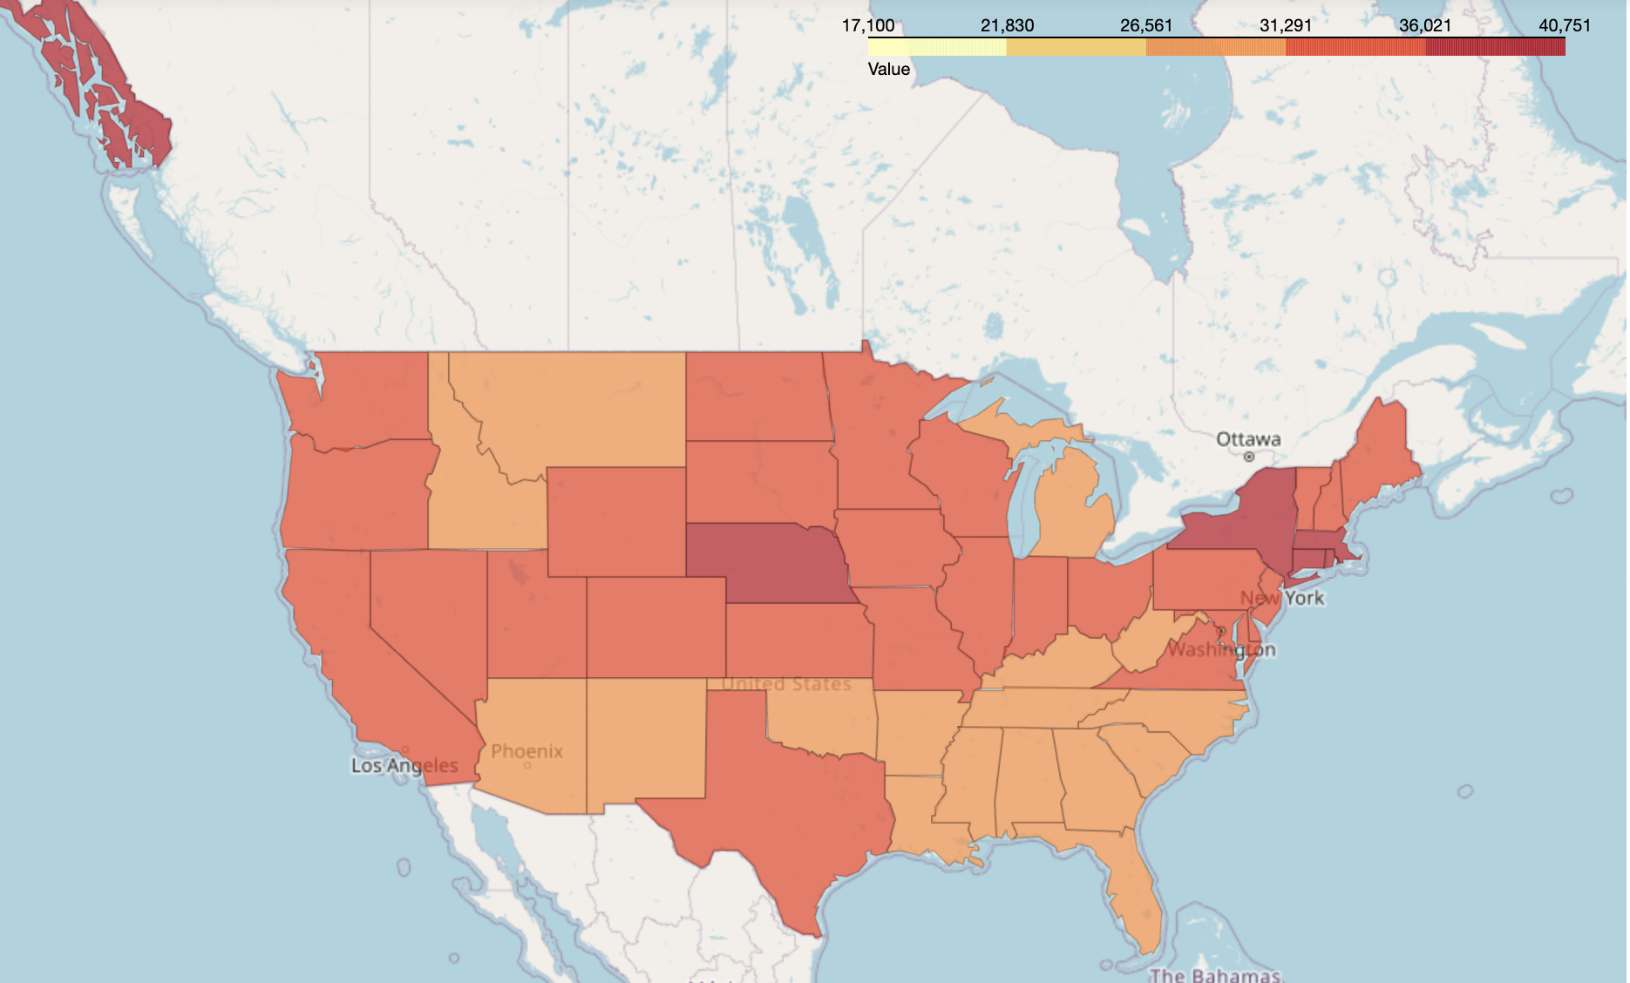
Average Earnings State-wise:
The costal vs inland difference is not so obvious.
Some states have significantly higher income. Reason: differences in industry(NY, MA, AK), workforce development, education.
Low mean earnings vs high enrollment size, i.e., CA, TX: not enough job opportunities compared with high demand for education.

Slide 41
Regression and Predictive Model (Leah)
Correlation Matrix
Regression Model
Predictive Model

Slide 42
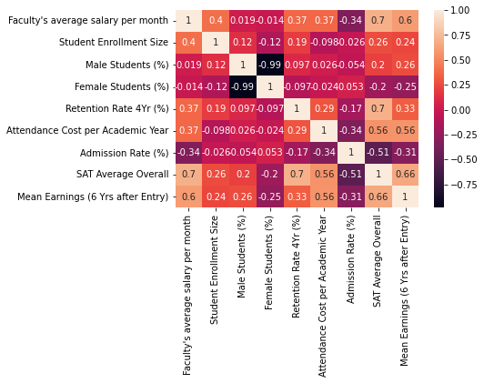
The correlation matrix of all the numeric variables that have more than 0.2 correlation coefficients with mean earnings 6 years after graduation.
SAT score and Faculty's monthly salary has the strongest correlation with meaning earnings after grad.
Percentage of male students has positive correlation with earnings while percentage of female students has negative correlation;
Admission rate also has negative correlation with earnings.

Slide 43
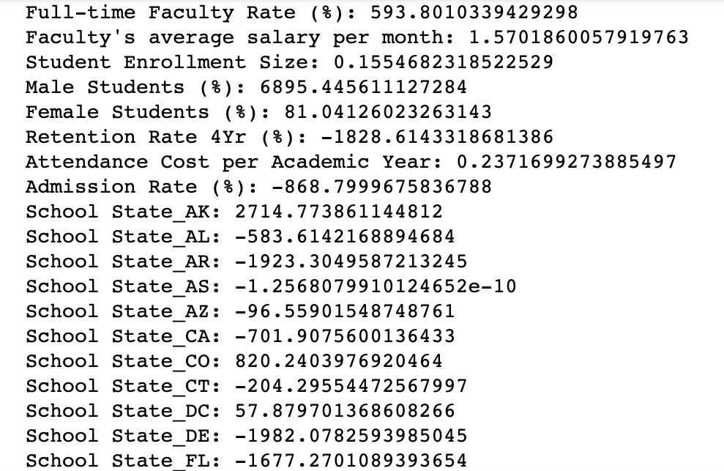
Regression Model
Input Variables
'School State' ( encoded)
'School Ownership'(encoded
'Full-time Faculty Rate (%)',
'Faculty's average salary per month'
'Student Enrollment Size'
'Male Students (%)'
'Female Students (%)'
'Retention Rate 4Yr (%)'
'Attendance Cost per Academic Year'
'Admission Rate (%)'
Outcome Variable
Meaning Earnings 6 Years After Graduation

Slide 44
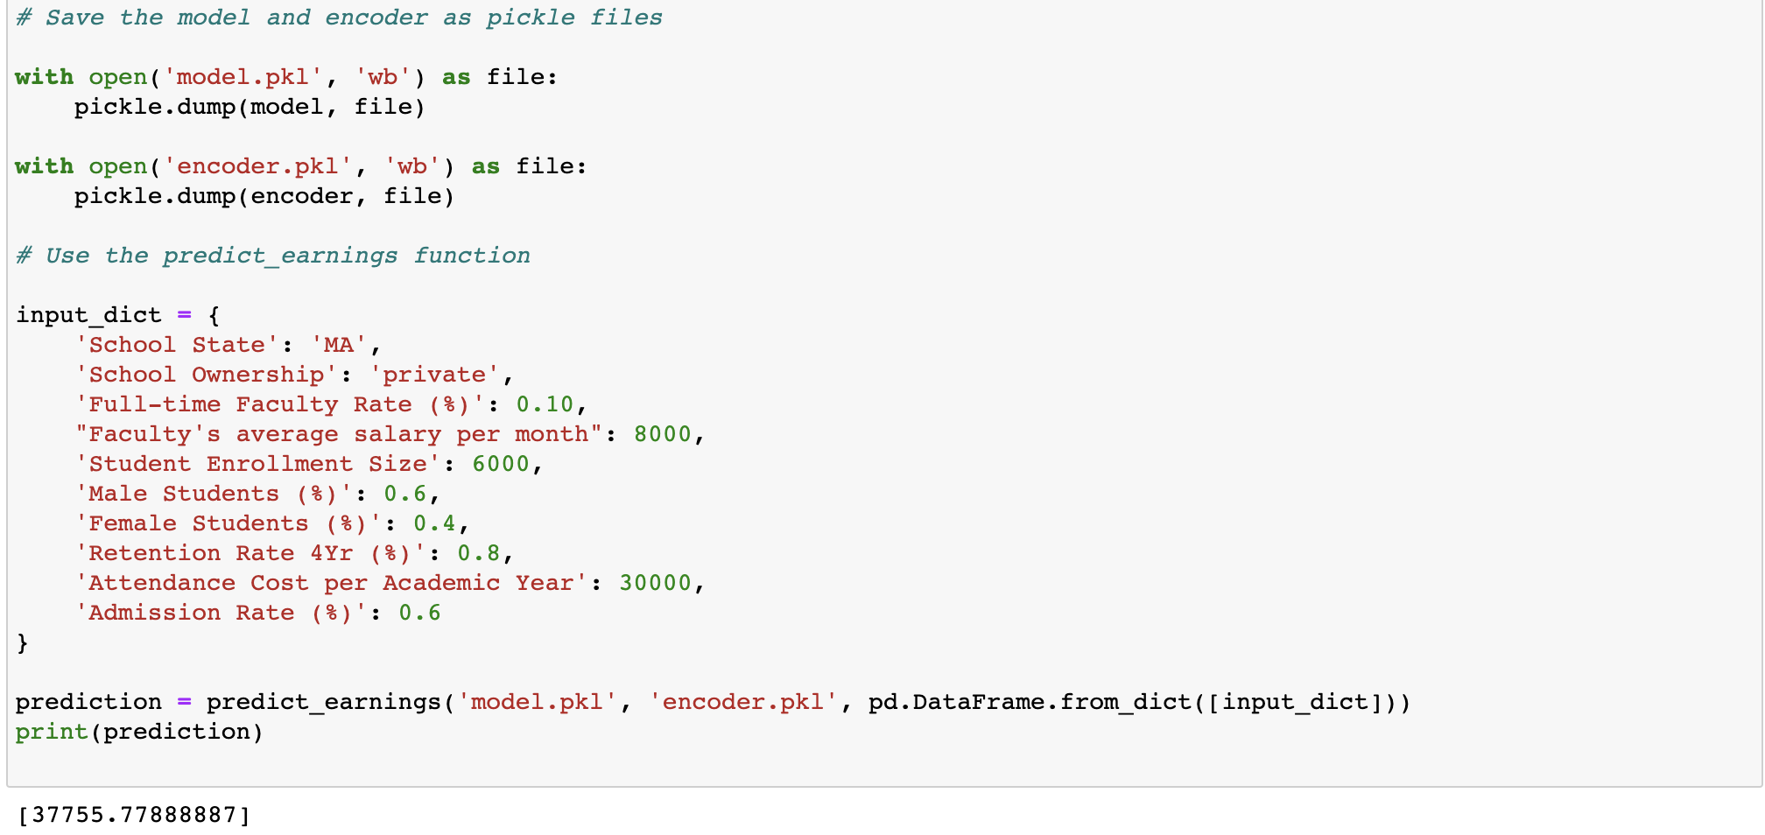
Prediction Model for Earnings after Graduate

Slide 45
Gender Differences - Key Findings
On average, ten years after enrollment at a University, male students earn about $60,000 more than female students
Students who attend smaller schools (less than 10,000 students undergraduate) earn more money, ten years later – both female and male
SAT scores have the strongest positive correlation with mean earnings – for both females and males
University admission rates have the strongest negative correlation with mean earnings – for both females and males

Slide 46
Key Findings
Costal areas in general have more educational resources than inland. However, the earnings of students after graduation are not so different across states except for some extremes.
Private school students have higher percentage of taking out loans than public school students
Higher education cost affects the salary 6 years after graduate but doesn’t significantly increase average earnings 10 years after graduation
Higher faculty salaries positively influence student completion rates up to a limit of $15,000 per month
Higher faculty salaries also contribute to higher wages for students after graduation

Slide 47
Thank you
Sources:
https://collegescorecard.ed.gov/;
https://www.python-graph-gallery.com/sankey-diagram-with-python-and-plotly;
https://python-visualization.github.io/folium/modules.html#module-folium.map.

